Slide 1

Business Valley
Team Blitzkrieg
Arya Chandra
BSc. Economics
Naman Madhur
BMS
Avipsha Ghosh
BA. Pol Science

Slide 2


Key partners
Key activities
Value proposition
Customer relations
Customer segments
Key Partners in this case would be our sholapith workers, the processing facility management, sholapith sellers. We would also have to reach out to companies that may use our product in the future.
The Key Activities required include the collection, processing, storage and later delivery to industrial clients. This will include branding, marketing, sales for distribution.
The biggest advantage of our product is undoubtedly the eco-friendly and sustainable nature of it. In a market dominated by extremely toxic and harmful products such as styrofoam, thermocol and other polyestrene materials, Sholapith packaging will be a game changer.
We look towards establishing a long term relationship with our target customers, i.e., bussinesses requiring packaging.
We plan to provide exclusive offers to our long term customers to value their trust in us and to ensure the continuance of the relationship.
We aim to provide sample materials to our first time customers to check the quality and sustainabilty of our product.
We would be catering to the increasing amount of the requirement of high amounts of protective packaging.
Consumer electronics and the manufacturing of industrial goods would be our main areas of focus. Along with this, we would be operating with the food and beverage industry as well as the healthcare industry.
We will also require the facility to take customer custom orders and process accordingly. Storage plays a major part in this.
Key Suppliers would be the village based shola farmers and suppliers who sit at the weekly haats.
In addition to that, we also have to deal with the suppliers of the various industrial equipments.
For the companies using our product, it will be a huge boost in brand image as every consumer now cares deeply about the materials they consume.
For revenue, most important activities include marketing, client onboarding and maintainence.
Primarily our focus would be dealing with B2B sectors and scaling into our targeted consumer base.
Channels
The Key Resources we are acquiring are the raw shola plant and the labour the employed craftsmen shall provide.
Key resources
We would be having a B2B business model. For that we will have a direct sales distribution channel. With the support of our direct sales team, we can ensure greater customer satisfaction and bigger margins.
In our long term goal, we plan on to introducing our D2C portal for shola crafts, through which we can have a bigger reach for the consumer sector.
In the long term, we plan on to coming into the D2C sector as well. Through our D2C platform Sholapith crafts can be made available to retail consumers, helping us gain more business and awareness while also providing another source of income to the skilled craftsmen. This will further encourage them to preserve the art
Our key resources include our physical processing facilities and machiner, our financial resources, our idea of the process behind the manufacturing and finally, the human resources we employ as in the sholapith craftsmen.
The key activities as performed by partners are the acquisition and processing of our raw sholapith plant and the supply of required machinery.
We shall need to acquire the machinery at optimum prices, maintain the physical venue well for long term production. Further, we need to train our personnel and provide skill training for effective sholapith processing. At some point, we will need sholapith farmers to tend to our production fields, as mentioned in our future plans.
Cost structure
Revenue streams
Our cost structure, while providing immense value to our customers, is a cost-driven structure. This means we will focus on keeping the price as low as possible while providing value to our stakeholders.
On the basis of how much we have of the stock in storage and how much demand around the year is, we will need to plan a cyclical costing plan per month/quarter. Furthermore, since ours is a mass produceable product, we can use the merits of mass production once we get to that stage.
The major cost heads we have are included in the finance section but for reference, it includes- Cost of raw materials, wages of sholapith artisans employed as workers, purchase value of machiner, rent for facility and warehouses for production and storage respectively. We also need a marketing budget to allow our brand to scale in the opening quarters/ over the long term.
The value for 1kg Thermocol and Styrofoam comes out to be around ₹160-₹200. The Market price of Sholapith being ₹148 will fit in just right. We can market our product on the basis of this competitive pricing. It being an eco friendly alternative will attract more eyeballs as well.
All our revenue is generated by the sheer value of our product- for a company, it boosts their brand image positively while being a more cost effective alternative- win win situation. Our revenue will depend on the volume the market demands in each quarter, but that should not fluctuate wildly. Rather, our revenue is only limited by the amount we can collect, process and store for future demand.
The current plan has only one major source of revenue- B2B sales to packagers and companies. Future plans include a D2C e-commerce platform selling shoalpith crafts- we will get a small commission per sale then.

Slide 3









Use of Harmful Materials in the Packaging Industry
Sholapith Artisans earn pathetic per diems currently.
Harmful products like thermocol and styrofoam are predominantly used as fillers in the packaging industry. Thermocol and Styrofoam are non-biodegradable products generating enormous amounts of waste each year.
Most forms of disposal of these products prove to be harmful leading to large scale pollution and health hazards.
The shola artisans earn as low as Rs. 30 per day, and with increasing prices of essential commodities it is becoming more and more difficult for them to survive on their craft while providing for the family.
If the profits of the shola workers do not increase there remains the possibility that this age-old art may face extinction.
In Addition, The United Nations has put forward 17 goals to be followed to ensure a sustainable future, most of which is being violated by the packaging industry presently.
The goals we see being violated, and wish to solve, are Goal 1 (Increased Poverty), Goal 8 (Lack of economic opportunity), Goal 9 (No innovation in packaging sector), Goal 10 (Increased Inequality), Goal 12 (Irresponsible production and consumption, Goal 13 (Adverse impact on Climate, and finally, Goal 15 (Adverse effect on life on land)

Slide 4









Truly Natural Alternative
Social Support Programme
Cheaper product, better brand image
Sholapith is a fully natural product, unlike the harmful styrofoam and thermocol in the market, and also unlike the artificially processed starch packing material sold as bio-degradable.
Our business model is developed keeping in mind the social obligation to protect the talented sholapith artisans in India. We provide gainful employment to these marginalized craftsmen.
Sholapith is much cheaper than the harmful styrofoam and thermocol packaging material. In addition to this, use of sustainable material will help companies boost brand image

Slide 5

Sholapith or Aeschynomene aspera is a milky-white spongey stem-plant found in abundance in wet marshy waterlogged areas in states such as Chhatisgarh, West Bengal and various areas in South India.
Once dried, this stem can be cut up into small pellets and has the same, or superior malleability, texture, durability and sponginess when compared to thermocol. This product is an alternative to the existing bio-degradable packaging peanuts made of wheat and starch as well, and is better in terms of how light it is. Further, sholapith also does not dissolve in water as the other biodegradable packing peanuts do, thus making it ideal for transporting heat sensitive materials to account for dampness and spillage. Shola has heat insulating properties as well.
Our business idea harnesses the eco-friendly sholapith and makes various packaging compenents- filler peanuts, bracers, insulation boxes.
The Social Aspect:
Through the manufacturing stages of our product, we not only reduce the waste generated by the usage of styrofoam/thermocol in packaging, but we also ensure soil fertility (Sholapith growth promotes the same) and provide employment to the Sholapith Craftsmen in our processing center.
Our Production Run looks like:
Collection of
the raw plant
Extraction &
Storage
Conversion &
Processing
Sale as B2B

Slide 6




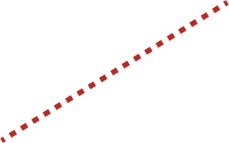
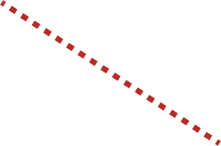



Market analysis and strategy
Target Market Details:
Go-To-Market Strategy
Main target market
1
Providing SEO-optimized content and cold calling/emailing
Our focus target market is constituted of major manufacturing companies in industries that require high amounts of packaging for their products.
We will write SEO-optimized blogs and articles on our website, leading to organic growth while building credibility. We will also use cold-calling and emailing to reach businesses directly. This is an age-old marketing technique for B2B business generation
2
Paid Ads and Sales Lead Generation
Using paid ads, both digital and physical mediums, is an indispensible tool for growth in the modern landscape of business. Flyer distribution among business houses, brochure distribution, even on-ground salesmen will help grow our market share.
Food and beverage
Healthcare sector
3
Certifications and Standard Verification
Sholapith has superior malleability and ductility over styrofoam resulting in more use cases.
Sholapith is soft and shock absorbent; suitable for packaging brittle dry foods like biscuits.
Sholapith has insulating properties; can be used for transporting heat sensitive medical supplies and materials
In such a safety related industry, our product must be certified as compatible with our use cases in mind. For this, we should strive for the BRCGS certification.
For our products to be certified as sustainable, we should achieve the Safer Choice certification by the Environmental Protection Agency.
4
Building and maintaining corporate trust
Total serviceable addressable market
We aim to provide sample materials to our first time customers to check the quality and sustainabilty of our product. We plan to provide exclusive offers to our long term customers to value their trust in us and to ensure the continuance of the relationship.
The styrofoam/thermocol packaging industry is huge, and sadly, the biodegradable packaging alternatives present today have not changed that.
Total SAM is around 7 billion USD as of today.
5
Seeking governmental/ NGO Support
For added monetary support as well as ad support, we shall approach NITI Aayog under the Green Initiative Programme.

Slide 7
















Eco-Conscious
Supporting Craft Artisans
Helping MSMEs
Supporting Make In India
Biodegradable product, cheaper than thermocol and styrofoam.
We provide a second livelihood to impoverished sholapith craftsmen.
Supporting small scale farmers; reducing import of packing peanuts.
Preserving Indian Heritage while employing rural sector in gainful production.
As is the case with green products and sustainable businesses, our entire growth hinges on whether we can make our customers, the businesses and their customers, the public, see value in our idea. To this effect, we must highlight the advantges our product has over the other alternatives in the market.
In the case of styrofoam/thermocol alternative, we have a clear edge by being biodegradable, locally-sourced naturally, and cheaper in the long term.
When it comes to the other starch and wheat based biodegradable alternatives, we must point out the social aspect of our product- the support system we aim to create for Sholapith craftsmen, farmers, and their families that depend on them for their daily meal.

Slide 8

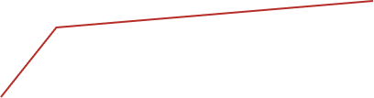










Porter’s five forces analysis
1. Competition In the market -
The market for biodegradable packaging is a niche one with few competitors, with Ecoware and Bluerose packaging among the top competitors in the market. Meanwhile, the market for Non - Biodegradable packaging is huge but its not sustainable and is a threat to the environment.
2. Potential of new entrants in the market -
The sector of sustainable packaging can only be penetrated by an entrant if they have the right quality of Sholapith and right infrastructure to support its production into packaging maetials. It requries sustainable scaling, as well as good local farm source maintainence.
3. Power of Suppliers
The shola farmers and vendors from the local villages who attend the weekly haats would be our major providers. In addition, we have to connect with the manufacturers and distributors of the various industrial equipment to assist with the whole process. Further, we are planning to use Sholapith artisans as the labour required in our processing facilities- technical training must be provided.
4. Power of Customers
Our product has a broad range of potential customers, ranging from industrial goods packaging to food and beverage sector and the healthcare industry, as well. Each of these businesses uses a significant amount of packaging, making this a great market for us to target.
5. Threat of Substitutes
There are some companies contending with us in this market space, with Ecoware being the biggest but it only provides solutions to the food and beverage sector thus creating a bigger opportunity for us to scale our product in the industrial packaging and healthcare sector. There is existence of smaller companies that produce batches of wheat-starch based biodegradable packing peanuts such as Bluerose Packaging.

Slide 9

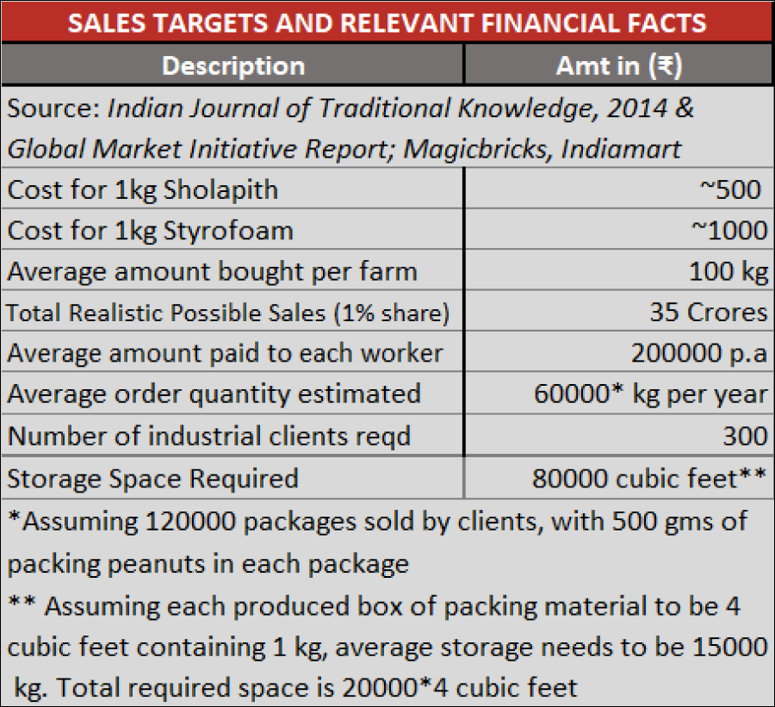
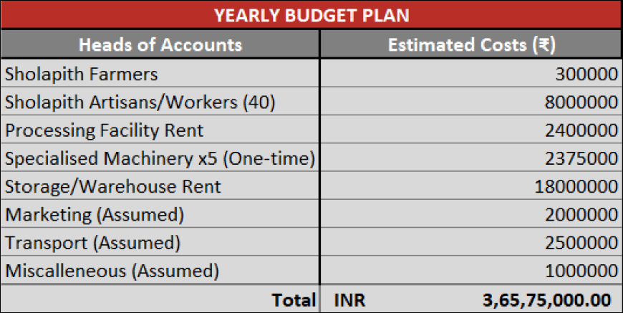
Most of the sales targets are created on the basis of some key financial facts.
The key facts include-
  Amazon, the E-commerce giant sells 60000 packages everyday. On that basis, we assume the realistic demand for Indian markets to be twice that figure per year.
  Using industry reports, we see that total market for packing peanuts in India is approx 7B USD. We assume that we are able to capture 1% of that market (USD to INR Exchange rate taken as 1$=70 Rs)
  We also assume that to provide enough support to sholapith craftsmen, 2 lakhs per annum per worker is minimum pay.

Slide 10
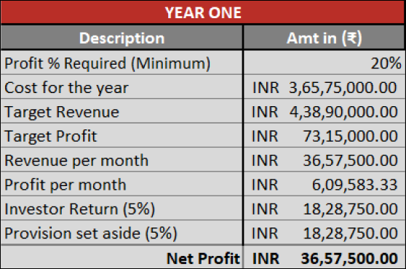
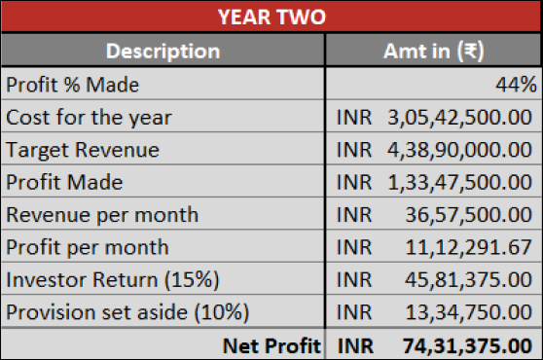
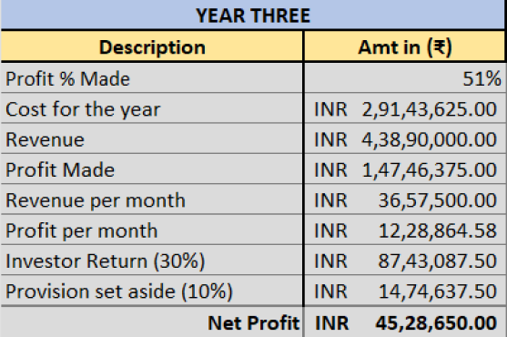
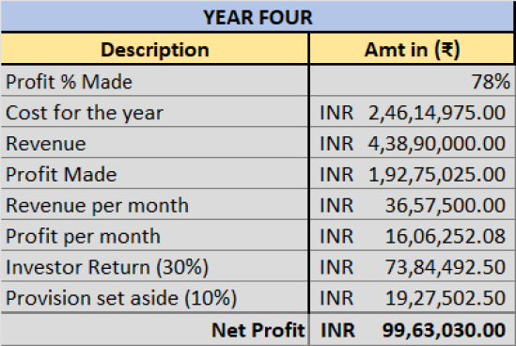
In the first year, we have the cost as calculated in the previous slide, including one time expenses of specialised macinery. We have assumed a minimum profit % of 20% so as to remain viable financially. On that basis, we provide a small return on investment to the investors at 5%
In the second year, we can see that the cost for the year decreasess, with the decrease in one-time expense of machinery purchase and the presence of last year’s profits. With that, we assume the same revenue as last year, and on that basis we can provide a higher percentage as ROI for the investors.
In the third year, we see that the cost per year continues to decrease with the increasing profit, revenue remaining constant. On this basis we can provide maximum returns to our investors as well, at a rate of 30% on their investment for the year.
In the fourth year, we see that the cost per year continues to decrease with the increasing profit, revenue remaining constant. On this basis we can provide maximum returns to our investors as well, at a rate of 30% on their investment for the year. This is the last year before we forecast break even,
In the fifth year, we forecast a break even. The profits from the business will cover cost for the year, and we can continue providing good rate of returns to the original investors with no further large investment required.

Slide 11

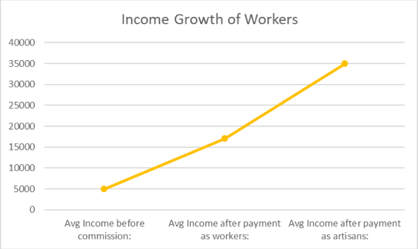
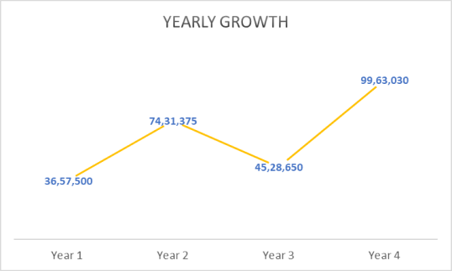
Future Plans And Sustainability
How our business is sustainable
1
Within 5 years we plan to open a D2C e-commerce website to grant a platform to shola artisans to sell their crafts. This will give them monetary incentive to continue preserving their craft and in turn, our heritage.
Our commission of mere 20% shall be taken to maintain the bussiness.
1
Improvement of soil quality on plantation of Sholapith.
2
Within 10 years we plan to start our own production of sholapith as well, by renting land and hiring farmers, for greater returns and conservation of the sholapith plant itself which is already threatened.
2
Overall change of packaging industry towards eco-friendly and sustainable future.
3
Within 15 years we plan to build an eco-friendly products brand in packaging focusing on biodegradable adhesives and tapes and viable non coventional alternatives to cellophane, etc.
3
Collaboration with Government to provide subsidies in land acquisition for future plantation as the entire area shall be benefitted.
4
Life in cities shall be healthier given the shift to natural products in such a widely required industry.
5
Improvement of livelihood of Sholapith craftsmen and processing facility workers.
6
Rural development of targeted states and alleviation of poverty.

